Slide 1


&
up running
-- w/--
progressive
|
web apps
Nik Molnar | @nikmd23
Notes:
Hi I’m Nik Molnar a developer living in Austin Texas
I tweet at nikmd23 and I blog at.
Today we’re going to cover Progressive web app fundamentals, and we’ll begin by exploring this idea of what is an app?
Setup:
Npm run gulp watch
Comment out .JS files
Kill cache and SW in Chrome
Reset Android Emulator: No browser tabs, uninstall SodaPopped
Open in VS:
Site.js
Sw.js
Manifest.json
Profile.js
AdminController.cs
Open in Chrome
http://www.caniuse.com/#feat=serviceworkers
Localhost:55194
https://developer.android.com/studio/index.html
chrome://inspect/
https://developers.google.com/web/tools/lighthouse/
https://developers.google.com/web/progressive-web-apps/checklist
http://www.caniuse.com/#feat=web-app-manifest
https://github.com/web-push-libs/
https://www.nuget.org/packages/WebPush/
https://web-push-codelab.appspot.com/
https://tests.peter.sh/notification-generator/
http://www.caniuse.com/#feat=push-api

Slide 2

reach vs. richness There are 10 kinds of people in the world. Those that understand binary, and those that don’t.
?


2004
Global
1998
2008



1992
Local
Text UI
Graphical UI
Natural UI
Notes:
To do that I’d like to begin by charting how applications have evolved over time, across two different axes
Rich is the ability to incorporate client side interactivity and intuitive user interfaces
Reach is the ability to make your application available to anyone, anywhere
1st: Local CLI’s
2nd: Graphical interfaces that leverage metaphors like a “desktop” or “folders”
3rd: Step back a bit in terms of richness, but go global with web 1.0
4th: Then the web continues to increase in richness over the years with Flash
And all was going well until 2007 when everything changed…
The iPhone came out Ushering in the modern era of the natural user interface that responded to touch, gestures and eventually voice control.
Companies are now forced to have IOS teams, and Android teams and other team for any other platform they want to ship to. What we really need to do is find a solution that can progress the state of application development up here, where richness and reach are both maximized.
Now you might be asking yourself, don’t we already have app models that are built from web technologies?

Slide 3

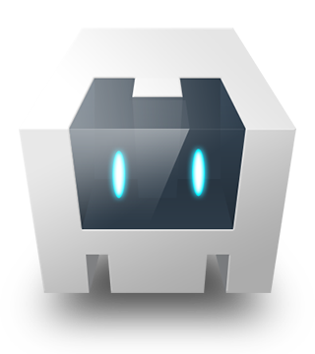




‘web’ app models #titanic { float: none; bottom: 0; }
Adobe AIR
Palm WebOS
Apache Cordova
Microsoft WinJS
Electron
W3C Widgets
Notes:
Well, yes we do.
Many platforms have tried to create an app model from web technologies,
but unfortunately, they also usually excluded on the of the web’s most important aspects: it’s deployment model.
So if none of these technologies are going to helps get our cake and eat it too, having both richness of UI and reach of application than what will?

Slide 4
progressive web apps ["hip", "hip"] // first person to figure this out and shout it out loud wins
1





responsive
work offline
app like
fresh
safe
2

⬄


3
discoverable
re-engageable
installable
linkable
Notes:
Progressive web apps begin life as 100% web – which gives us reach and all the properties of the web, but they also have the ability to be enhanced into rich apps that are first class citizens on the platforms that support them.
In reality, a progressive web app isn’t a new thing per se, many of the technologies that drive PWA’s have been around for awhile. What makes PWA’s special is really the fact that these technologies have been pulled together, and given a name. Like Jesse James Garrit for Ajax and Ethan Marcotte for Responsive Web Design.
Responsive: to fit any form factor
Connectivity independent: Progressively-enhanced with Service Workers to let them work offline
App-like-interactions: navigations & interactions
Fresh: Transparently always up-to-date thanks to the Service Worker update process
Safe: Served via TLS/HTTPS to prevent snooping
Discoverable: Are identifiable as “applications” thanks to W3C Manifests and Service Worker registration scope allowing search engines to find them
Re-engageable: Can access the re-engagement UIs of the OS; e.g. Push Notifications
Installable: to the home screen through browser-provided prompts, allowing users to “keep” apps they find most useful without the hassle of an app store
Linkable: meaning they’re zero-friction, zero-install, and easy to share. The social power of URLs matters.

Slide 5

progressive web apps Is every slide going to have one of these lame jokes?
These apps aren’t packaged and deployed through stores, they’re just websites that took all the right vitamins.
alex russell, Google
Notes:
In other words…

Slide 6
1

work offline.
Notes:
So let’s start with the first feature we’re going to cover

Slide 7
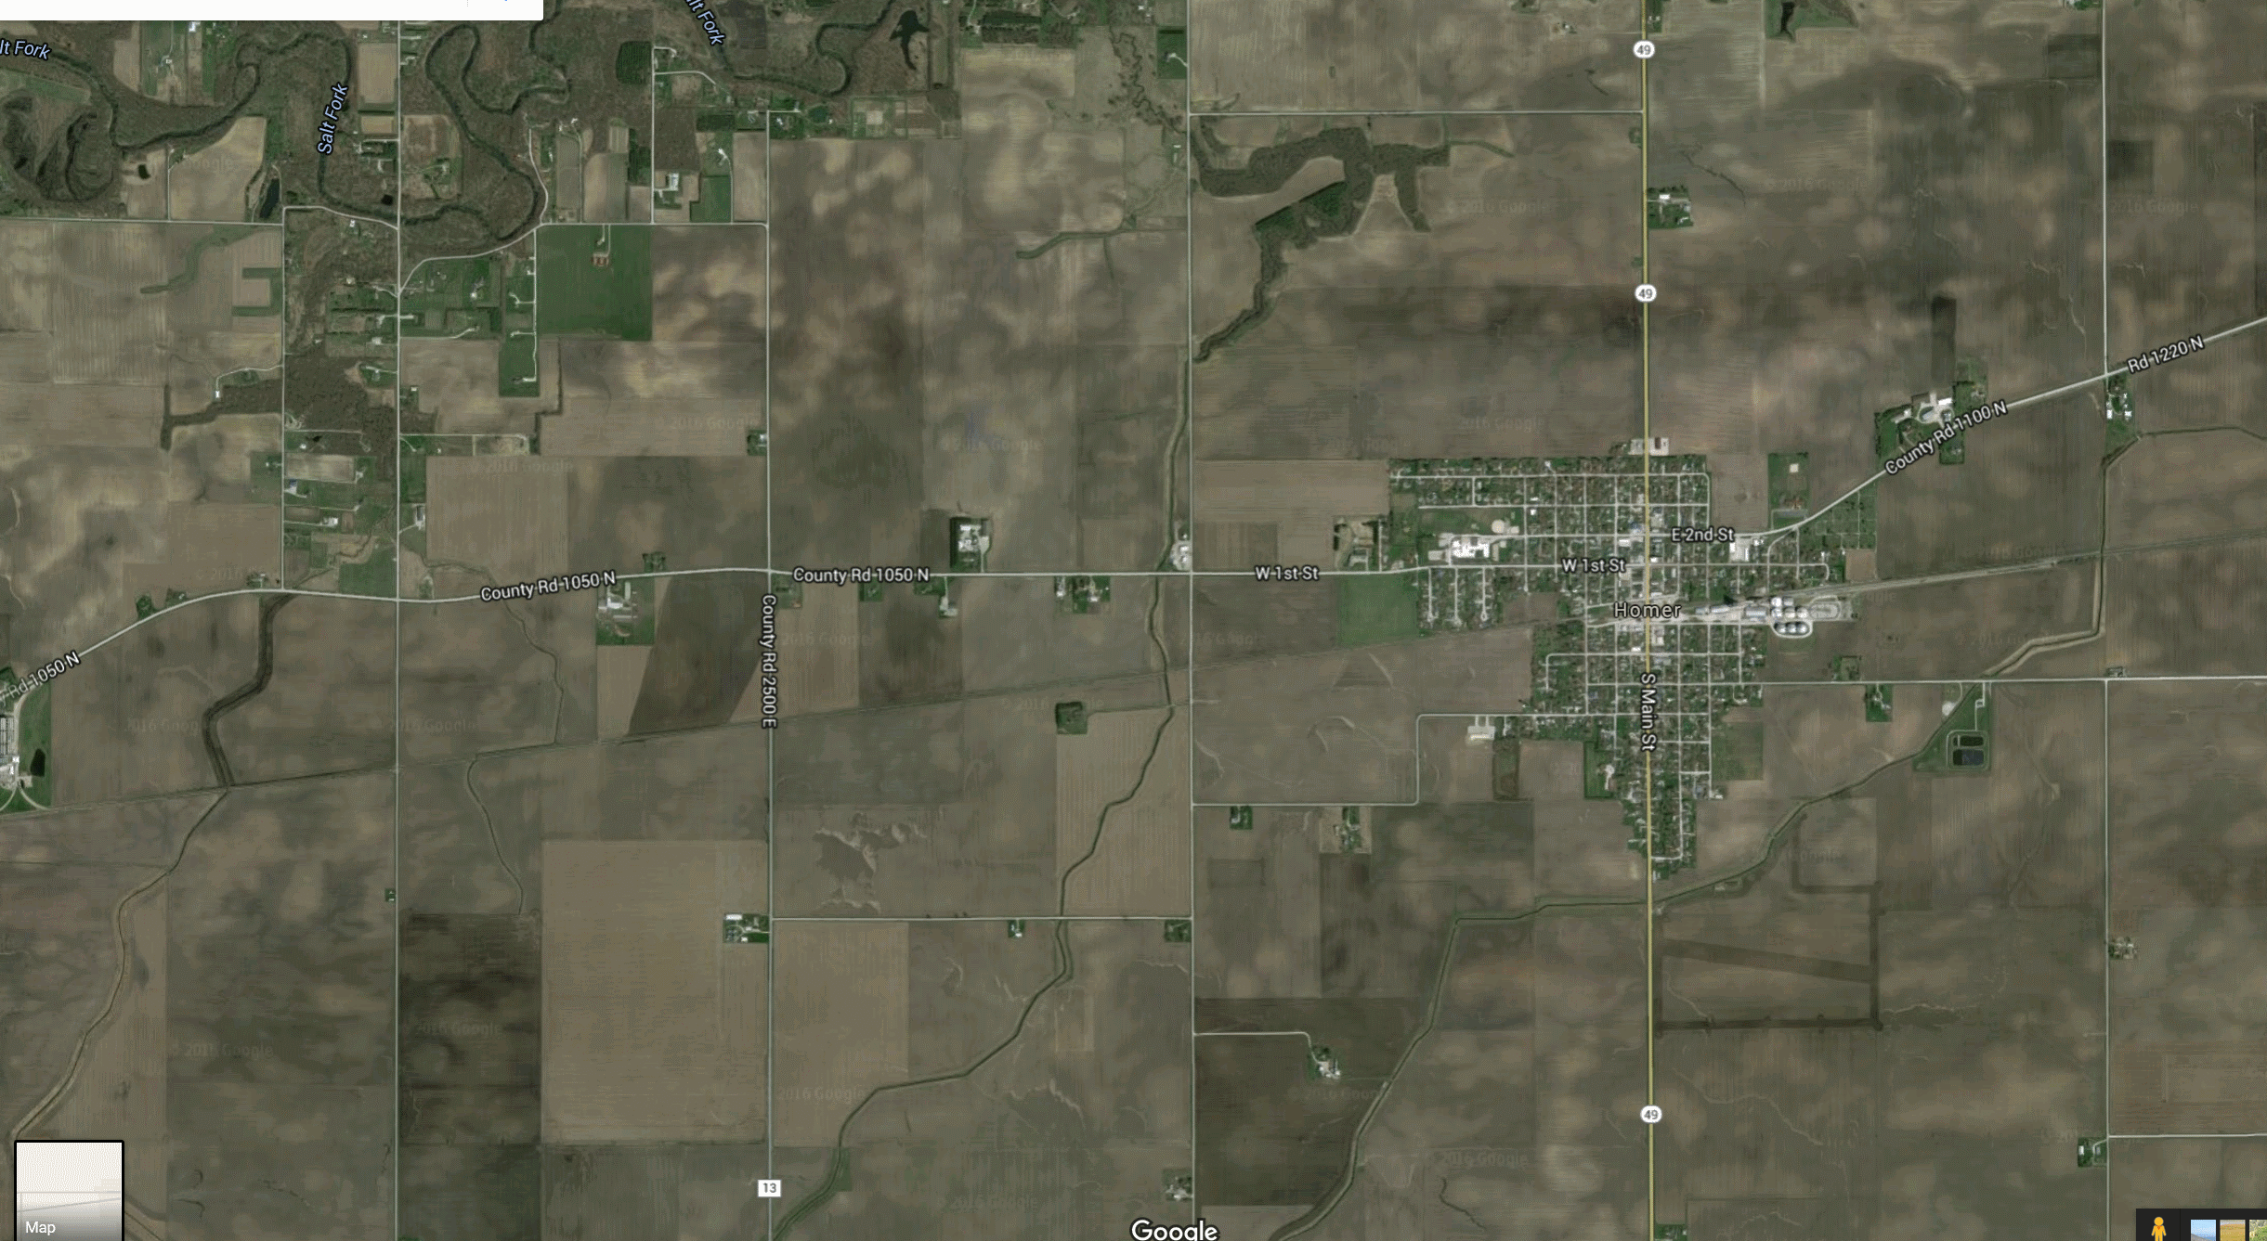



Notes:
Tell story of how on On June 4th at the homer soda festival I was going to use my app
Tell story of how on On June 4th at the homer soda festival I was going to use my app
DEMO HERE: Let me show you the app

Slide 8
connectively challenged This color is #BADA55.
❒



transport
crowds
inside
lie-fi
Notes:
There’s lots of places where offline can happen.
Transport: Planes, boats and ships, trains
Crowds: Concerts and sporting events where there are lots of people
Inside: Elevators and big buildings
LieFi

Slide 9
service worker overview Finally, this guy gets to some real content!





Slide 10
service worker overview Finally, this guy gets to some real content!






Slide 11
service worker overview Finally, this guy gets to some real content!






Notes:
everything seems to point at ServiceWorker being the most significant addition to the web platform since the introduction of AJAX – over 10 years ago - Nicolás Bevacqua
DEMO HERE: Build up a simple SW

Slide 12
2

installable.

Slide 13
app manifest
1f u c4n r34d th1s u r34lly n33d t0 g0 out51d3.
<link rel="manifest" href="/manifest.json">
Notes:
Using a web app manifest couldn't be easier, you just add a link tag to your pages with a rel of manifest and point the href to your manifest’s json file.
Let’s take a look at what goes into the manifest.json file.

Slide 14
app manifest
1f u c4n r34d th1s u r34lly n33d t0 g0 out51d3.
<link rel="manifest" href="/manifest.json">
{
"name": "SodaPopped",
"short_name": "SodaPopped",
"start_url": "/",
"background_color": "#3498DB",
"theme_color": "#34495E",
"orientation": "portrait-primary",
"display": "standalone",
"icons": [{
"src": "/path/to/image.ext",
"type": "image/png",
"sizes": "192x192"
}]
}

Slide 15
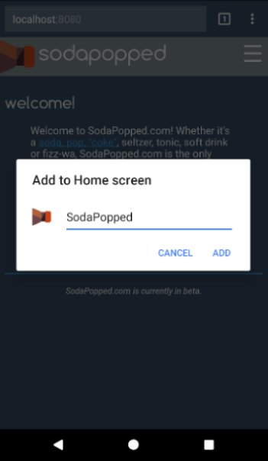
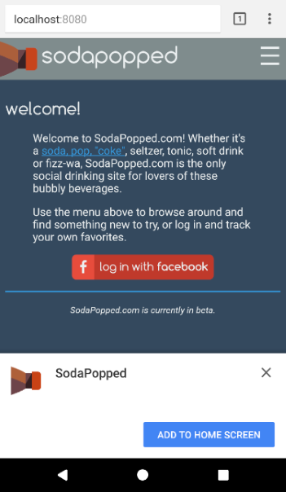
app manifest
1f u c4n r34d th1s u r34lly n33d t0 g0 out51d3.
<link rel="manifest" href="/manifest.json">
{
"name": "SodaPopped",
"short_name": "SodaPopped",
"start_url": "/",
"background_color": "#3498DB",
"theme_color": "#34495E",
"orientation": "portrait-primary",
"display": "standalone",
"icons": [{
"src": "/path/to/image.ext",
"type": "image/png",
"sizes": "192x192"
}]
}
Identity
Notes:
The two properties used for identifying your app are name and short_name.
The short name property shows up under app icon on the home screen

Slide 16
app manifest
1f u c4n r34d th1s u r34lly n33d t0 g0 out51d3.
<link rel="manifest" href="/manifest.json">
{
"name": "SodaPopped",
"short_name": "SodaPopped",
"start_url": "/",
"background_color": "#3498DB",
"theme_color": "#34495E",
"orientation": "portrait-primary",
"display": "standalone",
"icons": [{
"src": "/path/to/image.ext",
"type": "image/png",
"sizes": "192x192"
}]
}
Presentation
Notes:
The start_url is the url that will be opened when the user launches your app for the first time. I’m just showing user the home page of my app right now, but I might want to have a specific app starting url, or even add a query string that tells me this user is opening the app from their home screen.

Slide 17
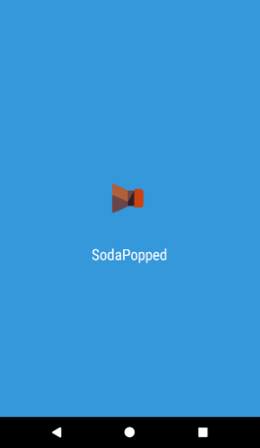
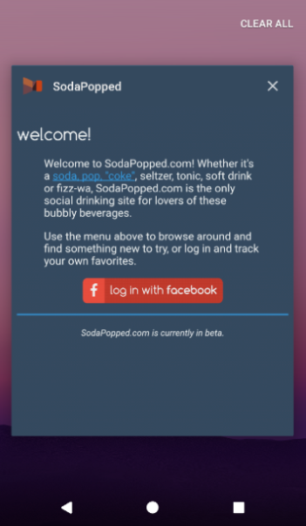
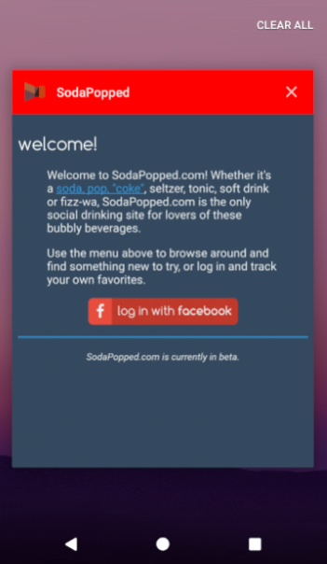
app manifest
1f u c4n r34d th1s u r34lly n33d t0 g0 out51d3.
<link rel="manifest" href="/manifest.json">
{
"name": "SodaPopped",
"short_name": "SodaPopped",
"start_url": "/",
"background_color": "#3498DB",
"theme_color": "#34495E",
"orientation": "portrait-primary",
"display": "standalone",
"icons": [{
"src": "/path/to/image.ext",
"type": "image/png",
"sizes": "192x192"
}]
}
Presentation
Notes:
The next presentation properties are background color and theme color.

Slide 18
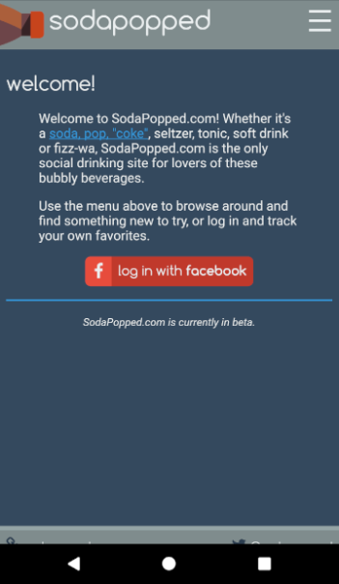
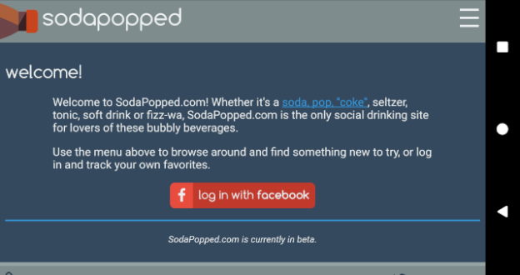
app manifest
1f u c4n r34d th1s u r34lly n33d t0 g0 out51d3.
<link rel="manifest" href="/manifest.json">
{
"name": "SodaPopped",
"short_name": "SodaPopped",
"start_url": "/",
"background_color": "#3498DB",
"theme_color": "#34495E",
"orientation": "portrait-primary",
"display": "standalone",
"icons": [{
"src": "/path/to/image.ext",
"type": "image/png",
"sizes": "192x192"
}]
}
Presentation
Notes:
Orientation can be presentation or landscape

Slide 19
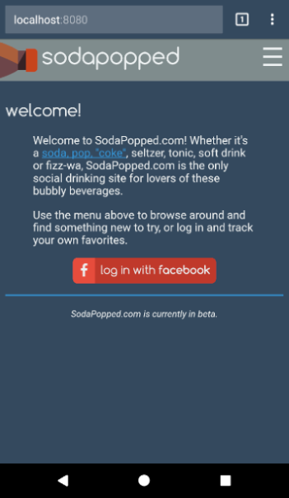
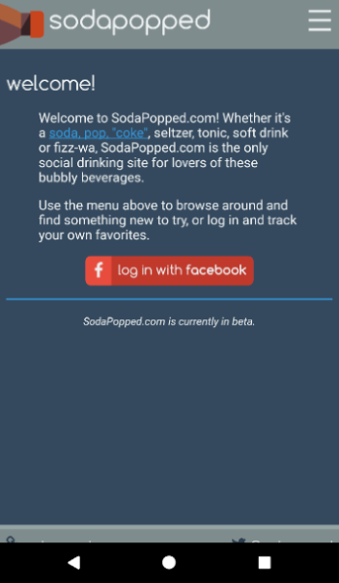
app manifest
1f u c4n r34d th1s u r34lly n33d t0 g0 out51d3.
<link rel="manifest" href="/manifest.json">
{
"name": "SodaPopped",
"short_name": "SodaPopped",
"start_url": "/",
"background_color": "#3498DB",
"theme_color": "#34495E",
"orientation": "portrait-primary",
"display": "standalone",
"icons": [{
"src": "/path/to/image.ext",
"type": "image/png",
"sizes": "192x192"
}]
}
Presentation
Notes:
We mostly want to use standalone for the most app like behavior.

Slide 20
app manifest
1f u c4n r34d th1s u r34lly n33d t0 g0 out51d3.
<link rel="manifest" href="/manifest.json">
{
"name": "SodaPopped",
"short_name": "SodaPopped",
"start_url": "/",
"background_color": "#3498DB",
"theme_color": "#34495E",
"orientation": "portrait-primary",
"display": "standalone",
"icons": [{
"src": "/path/to/image.ext",
"type": "image/png",
"sizes": "192x192"
}]
}
Icons

Notes:
Icons are used in many different places in the experience.

Slide 21
install banner requirements A common programming solution is to use threads. But then, two ‘llyou hav erpoblesm.
secure site with green lock icon
registered service worker
offline experience
app manifest with:
name
short_name
icons at least 144x144
start_url
display = standalone | fullscreen

Slide 22
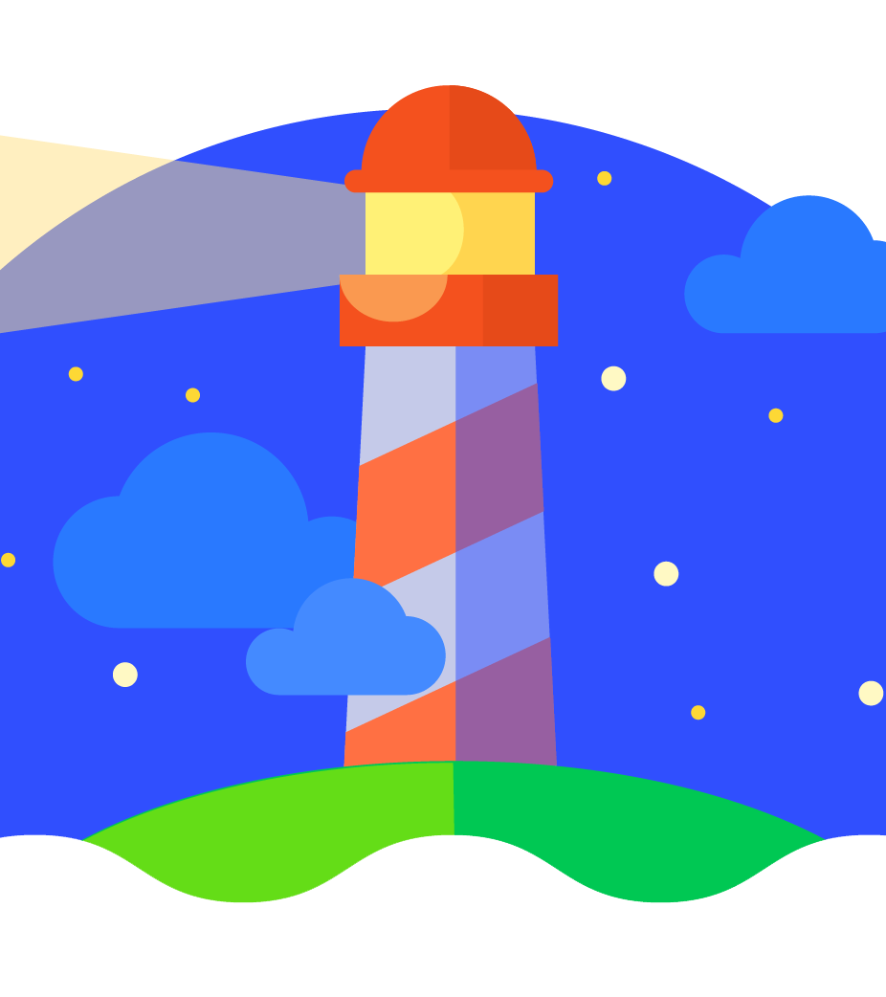




lighthouse
These jokes aren’t bad. They’re in “beta”.
built by Google
open source
Chrome extension
npm module


Slide 23
3
⬄
re-engageable.

Slide 24




web push overview Oct 31 == Dec 25, so Halloween is Christmas.





configure push

Notes:
There’s three phases to making push notification work
Registering a subscription

Slide 25
web push overview Oct 31 == Dec 25, so Halloween is Christmas.





configure push
send message

Notes:
Pushing a message to the device

Slide 26
web push overview Oct 31 == Dec 25, so Halloween is Christmas.



⬄
1


configure push
send message

receive message

Notes:
Handling the push and opening a notification

Slide 27
reach vs. richness Fun Fact: The word “algorithm” was coined in tribute to Al Gore’s contribution to computer science.
future is
promising


Global



Local
Text UI
Graphical UI
Natural UI
Notes:
So, with that, I hope you can see and understand that the future of the web and pwa’s is promising

Slide 28
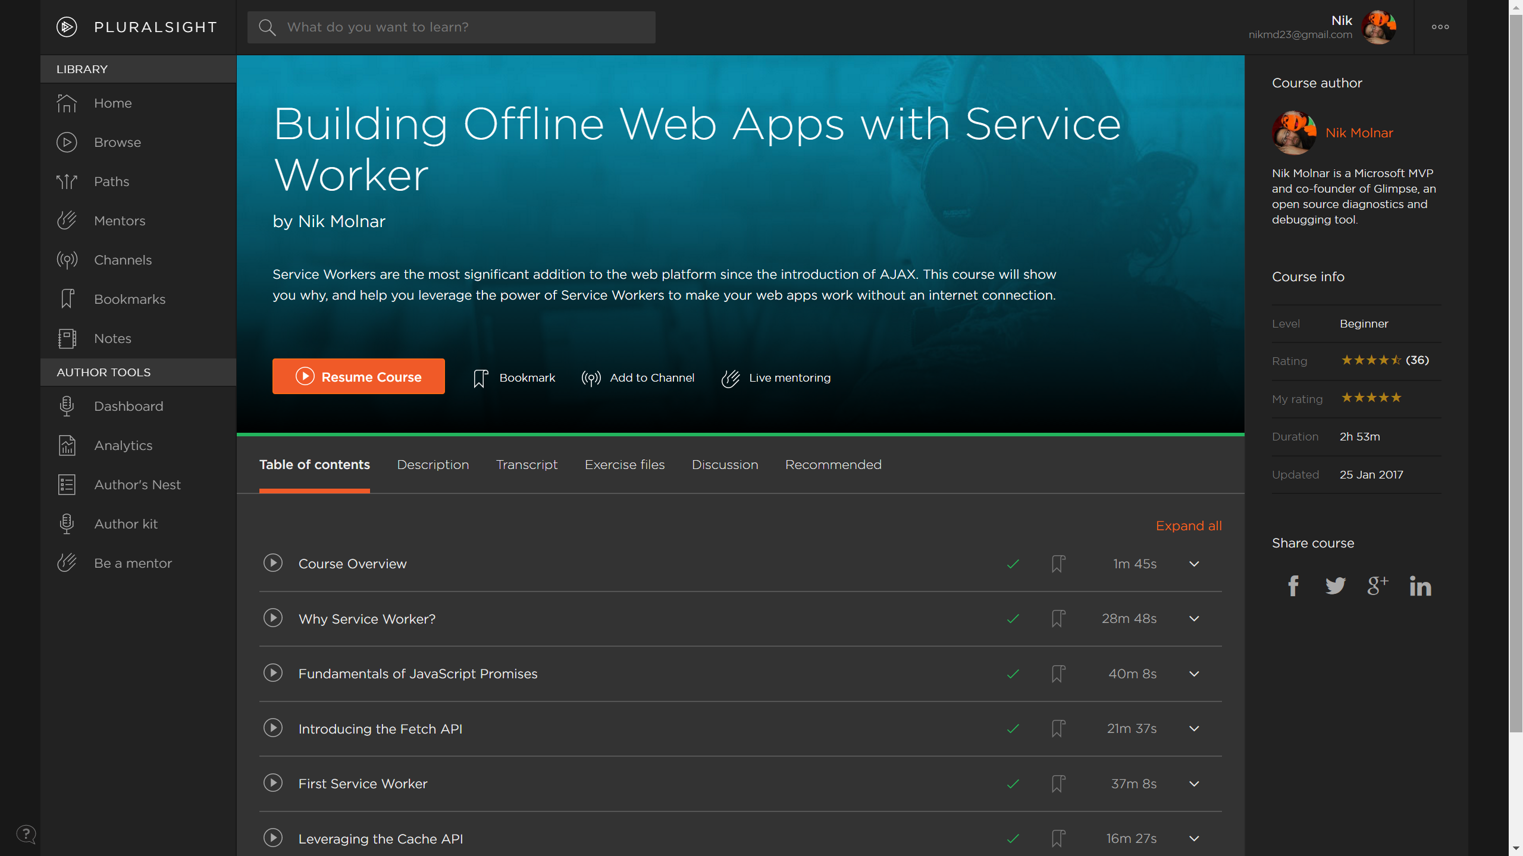

Slide 29
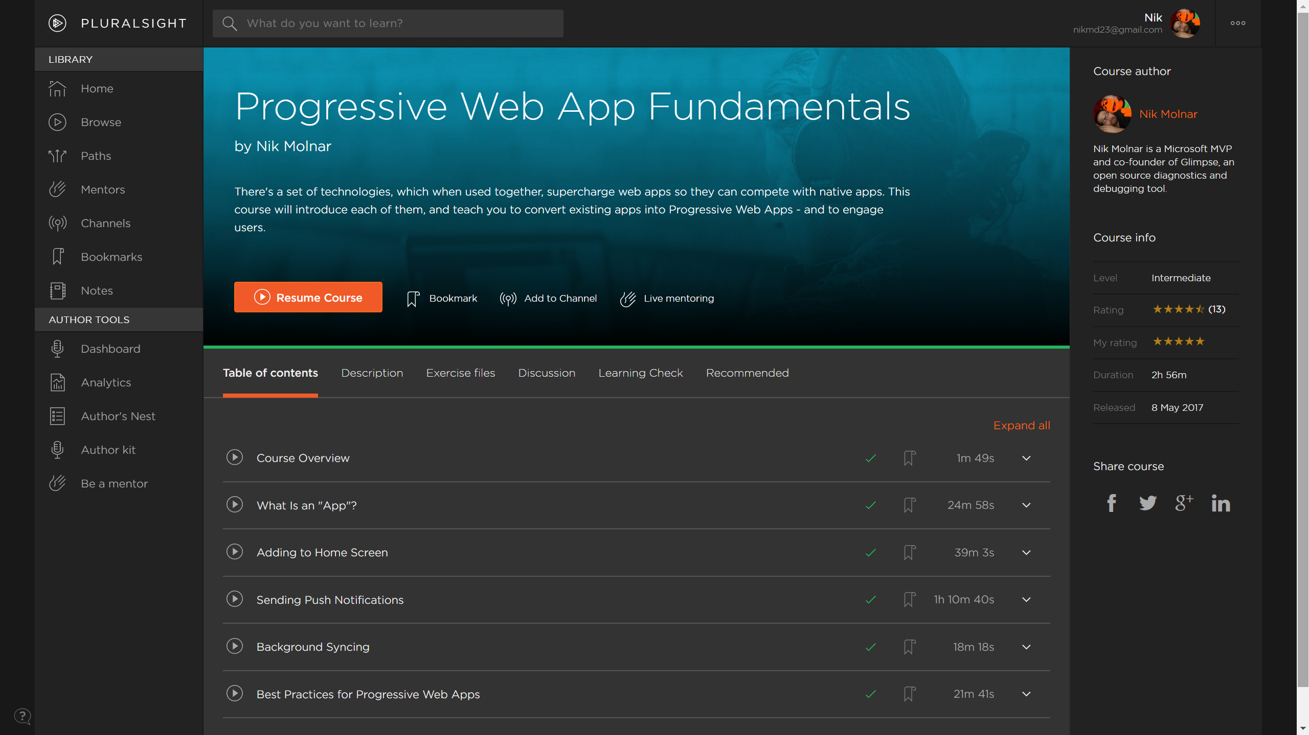

Slide 30

thanks!
questions & answers
Send complaints to: trash@molnar.com

nikmd23
·
nikcodes.com
pluralsight
https://nikcodes.com/pwa-fundamentals

